Slide 1






Linear vs. nonlinear models on a numerical black hole ringdown
Speaker: Yi Qiu
Collaborators: Xisco Jiménez Forteza, Pierre Mourier

Slide 2
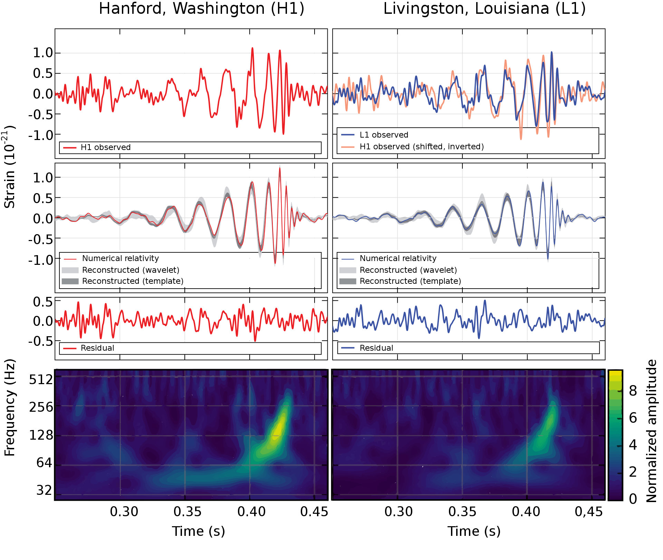
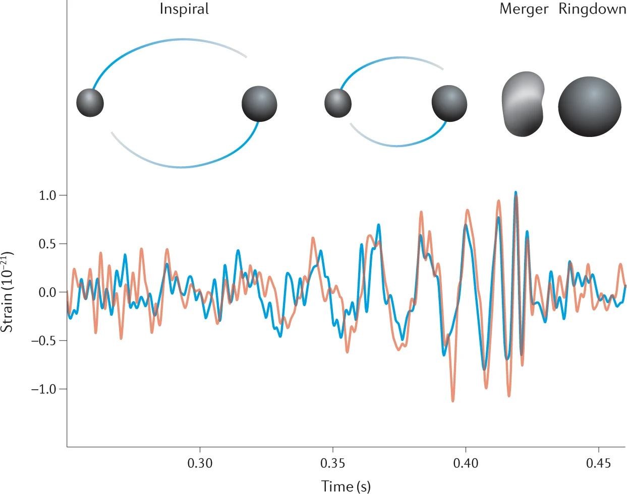
Why ringdown test?
Images credits: The LIGO and Virgo Collaborations, PhysRevLett.116.061102 (2016).
Ringdown quasi-normal-mode (QNM) frequencies uniquely determined by the final BH’s mass and spin as predicted by the no-hair theorem in general relativity (GR).
Testing no-hair theorem:
Blackhole spectroscopy
Inspiral-merger-ringdown (IMR) consistency test
Notes:
Mention just BBH

Slide 3
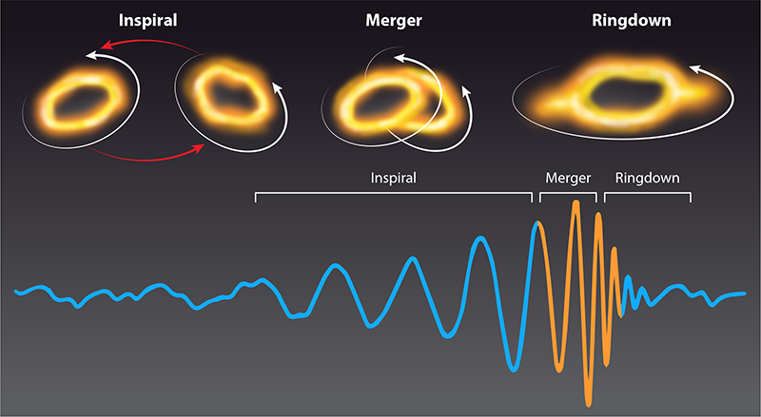
Linear vs. nonlinear
Nonlinearity in the merger phase.
Image credit: APS/articles/v16/29 (2023).
Linear
Linear perturbation applied from the peak strain onward.
Nonlinear effects observed at the merger regime become quickly irrelevant.
Includes a large number of tones, typically N=7 overtone model.
Issues in “linear” models
Instability of the high overtone models -- overfitting.
Un-modelled nonlinearity on the dominant (l, m) = (2, 2) mode.
Mode mixing, prompt emission, late tail effects, etc.

Slide 4
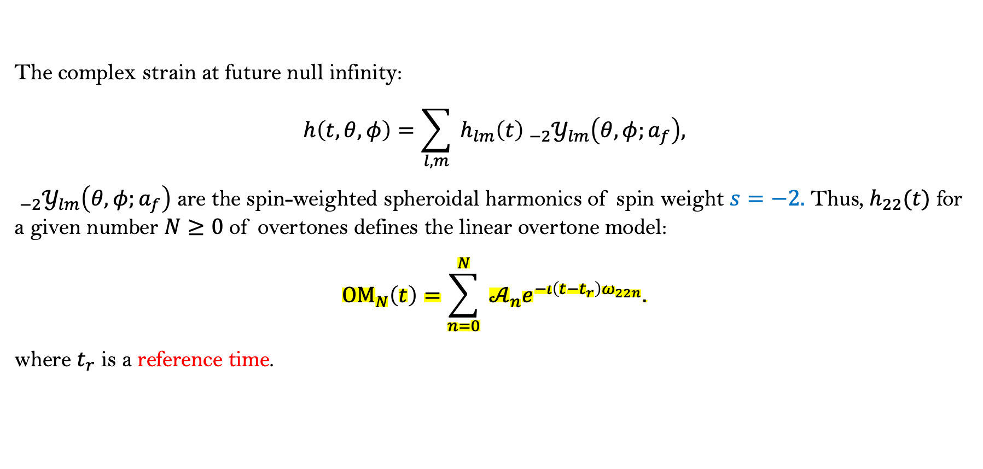
Linear models
QNM overtone models
Teukolsky equation describes linear perturbations off a Kerr background spacetime.
Its solution is the countably infinite set of the complex QNMs of the final (Kerr) BH.
The complex strain at future null infinity:
$$h\left(t,θ,φ\right)=\sum_{l,m}{ }h_{lm}\left(t\right) _{−2}𝒴_{lm}\left(θ,φ;a_{f}\right),$$
$_{−2}𝒴_{lm}\left(θ,φ;a_{f}\right)$ are the spin-weighted spheroidal harmonics of spin weight $s=−2.$ Thus, $h_{22}(t)$ for a given number $N≥0$ of overtones defines the linear overtone model:
$${OM}_{N}\left(t\right)=\sum_{n=0}^{N}{ }𝒜_{n}e^{−ι\left(t−t_{r}\right)ω_{22n}}.$$
where $t_{r}$ is a reference time.

Slide 5
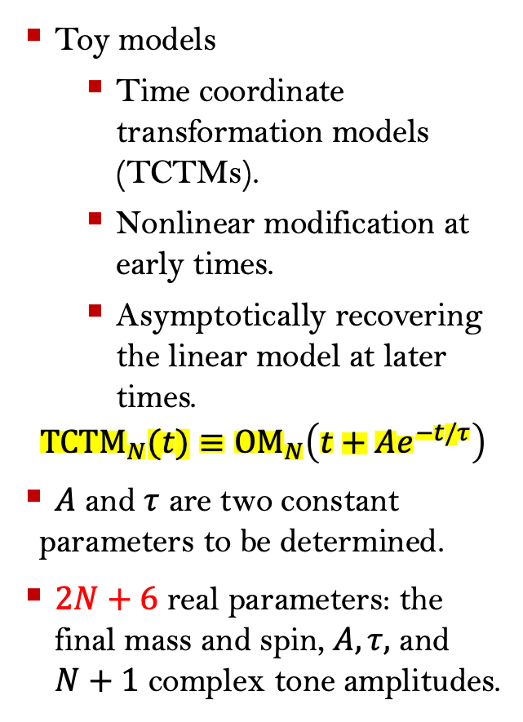
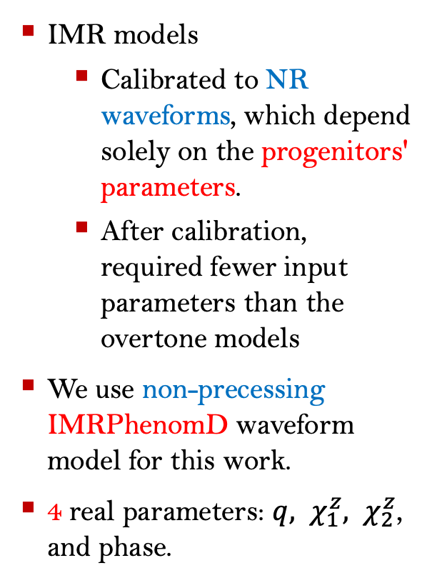
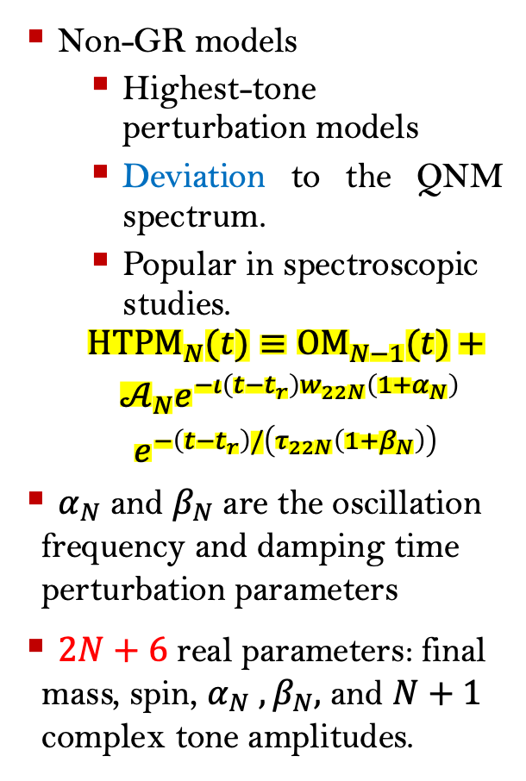
Nonlinear models & non-GR model
IMR models
Calibrated to NR waveforms, which depend solely on the progenitors' parameters.
After calibration, required fewer input parameters than the overtone models
We use non-precessing IMRPhenomD waveform model for this work.
4 real parameters: ${q, χ}_{1}^{z}, χ_{2}^{z}$, and phase.
Toy models
Time coordinate transformation models (TCTMs).
Nonlinear modification at early times.
Asymptotically recovering the linear model at later times.
$${TCTM}_{N}(t)≡{OM}_{N}\left(t+Ae^{−t/τ}\right)$$
$A$ and $τ$ are two constant parameters to be determined.
$2N+6$ real parameters: the final mass and spin, $A,τ,$ and $N+1$ complex tone amplitudes.
Non-GR models
Highest-tone perturbation models
Deviation to the QNM spectrum.
Popular in spectroscopic studies.
$$\begin{matrix} & {HTPM}_{N}⁡(t)≡{OM}_{N−1}(t)+ \\ & \begin{aligned} 𝒜_{N}e^{−ι\left(t−t_{r}\right)w_{22N}\left(1+α_{N}\right)} \\ e^{−\left(t−t_{r}\right)/\left(τ_{22N}\left(1+β_{N}\right)\right)}\end{aligned}\end{matrix}$$
$α_{N}$ and $β_{N}$ are the oscillation frequency and damping time perturbation parameters
$2N+6$ real parameters: final mass, spin, $α_{N}$ $,β_{N},$ and $N+1$ complex tone amplitudes.

Slide 6
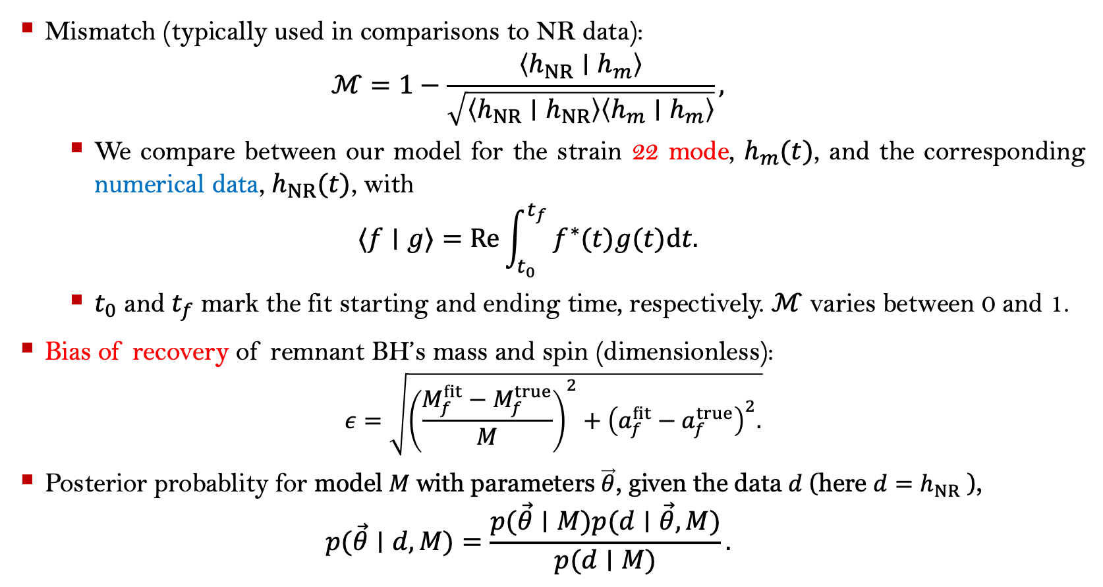
Model comparison
Mismatch (typically used in comparisons to NR data):
$$ℳ=1−\frac{\left\langle h_{NR}∣h_{m}\right\rangle }{\sqrt{\left\langle h_{NR}∣h_{NR}\right\rangle \left\langle h_{m}∣h_{m}\right\rangle }},$$
We compare between our model for the strain 22 mode, $h_{m}(t)$, and the corresponding numerical data, $h_{NR}(t)$, with
$$⟨f∣g⟩=Re⁡\int_{t_{0}}^{t_{f}}{ }f^{∗}(t)g(t)dt.$$
$t_{0}$ and $t_{f}$ mark the fit starting and ending time, respectively. $ℳ$ varies between 0 and 1.
Bias of recovery of remnant BH’s mass and spin (dimensionless):
$$ε=\sqrt{{\left(\frac{M_{f}^{fit}−M_{f}^{true}}{M}\right)}^{2}+{\left(a_{f}^{fit}−a_{f}^{true}\right)}^{2}.}$$
Posterior probablity for model $M$ with parameters $\vec{θ}$, given the data $d$ (here $d=h_{NR}$ ),
$$p(\vec{θ}∣d,M)=\frac{p(\vec{θ}∣M)p(d∣\vec{θ},M)}{p(d∣M)}.$$
Notes:
Norm/distance

Slide 7
Preliminary tests
Grid method on mass and spin ($+A/τ$ or $α_{N}/β_{N}$) --- linear fitting implemented at each grid point, then find minimum mismatch using bisection.

Slide 8
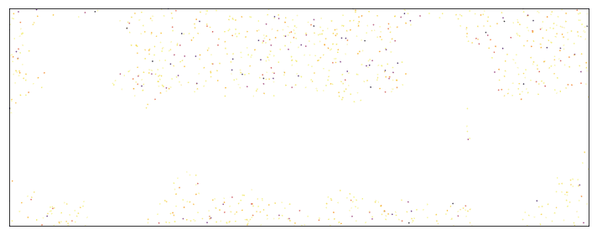
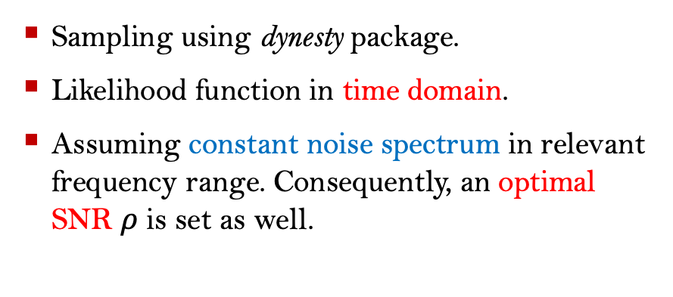
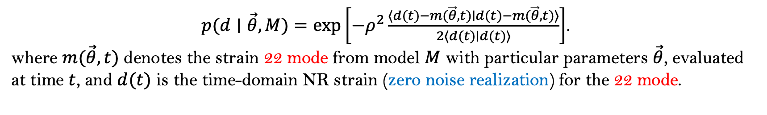
Parameter estimation
Sampling using dynesty package.
Likelihood function in time domain.
Assuming constant noise spectrum in relevant frequency range. Consequently, an optimal SNR $ρ$ is set as well.
$p(d∣\vec{θ},M)=exp⁡\left[−ρ^{2}\frac{⟨d(t)−m(\vec{θ},t)∣d(t)−m(\vec{θ},t)⟩}{2⟨d(t)∣d(t)⟩}\right]$.
where $m(\vec{θ},t)$ denotes the strain 22 mode from model $M$ with particular parameters $\vec{θ}$, evaluated at time $t$, and $d(t)$ is the time-domain NR strain (zero noise realization) for the 22 mode.

Slide 9
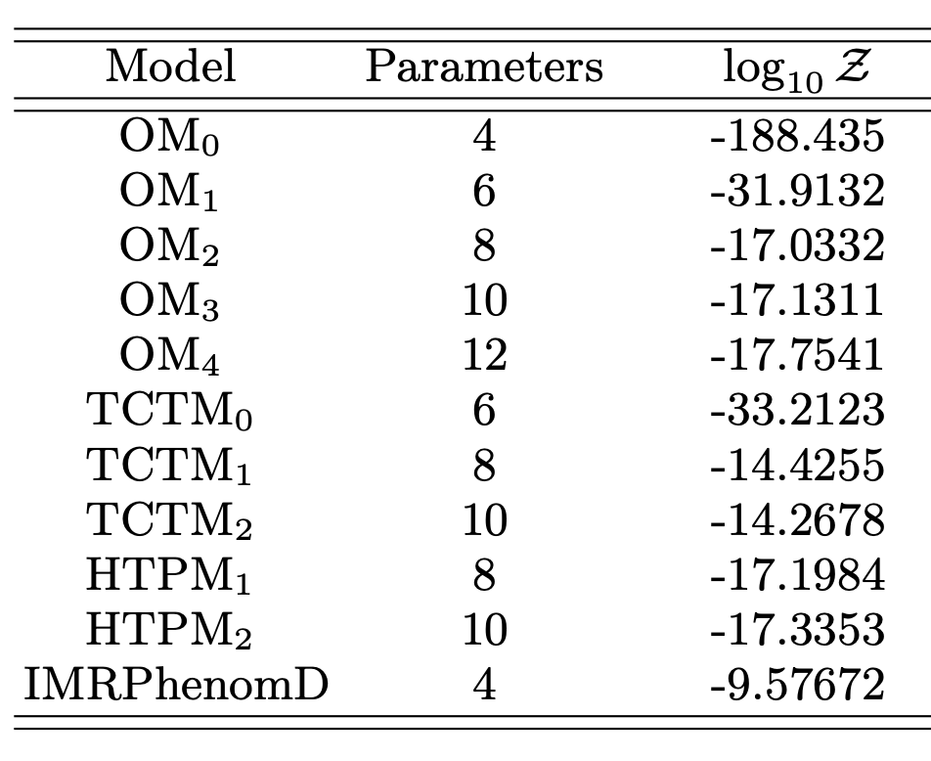
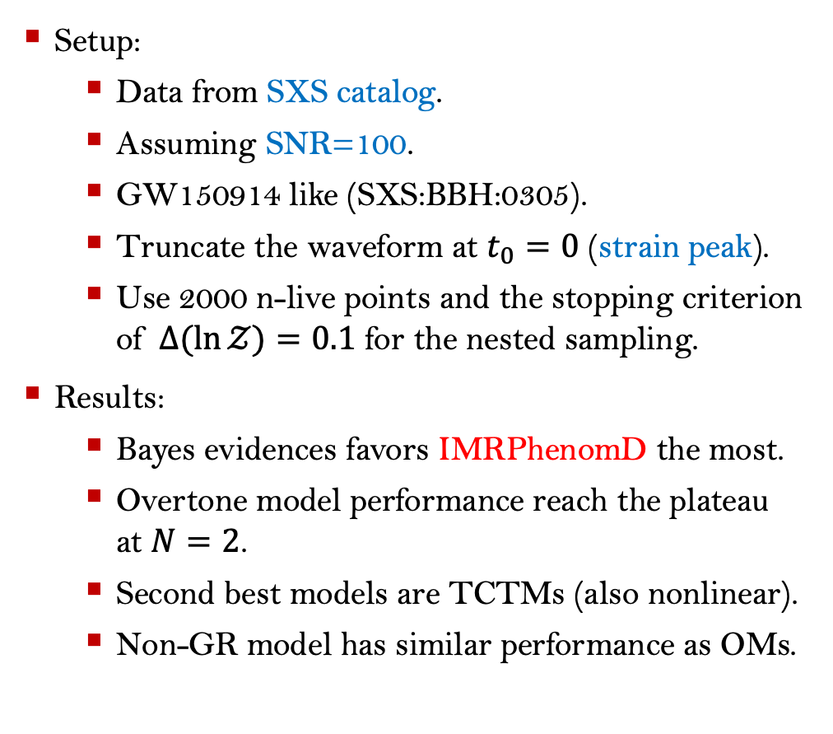
Bayesian analysis
Setup:
Data from SXS catalog.
Assuming SNR=100.
GW150914 like (SXS:BBH:0305).
Truncate the waveform at $t_{0}=0$ (strain peak).
Use 2000 n-live points and the stopping criterion of $Δ(ln⁡𝒵)=0.1$ for the nested sampling.
Results:
Bayes evidences favors IMRPhenomD the most.
Overtone model performance reach the plateau at $N=2$.
Second best models are TCTMs (also nonlinear).
Non-GR model has similar performance as OMs.

Slide 10
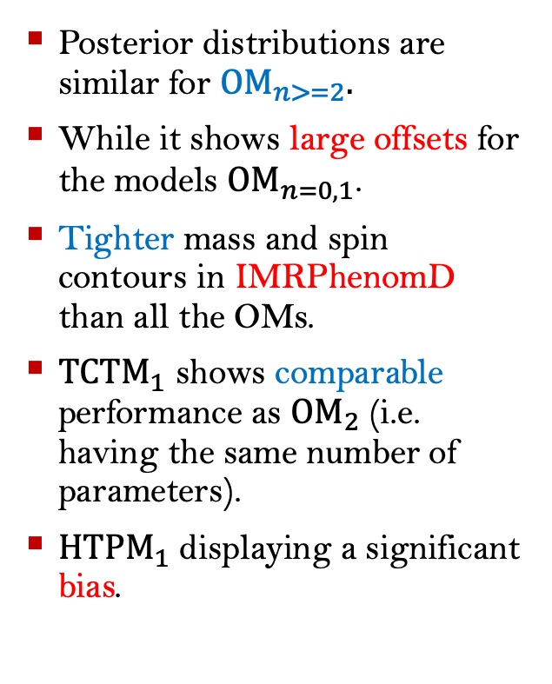
Posterior distribution
Posterior distributions are similar for ${OM}_{n>=2}.$
While it shows large offsets for the models ${OM}_{n=0,1}$.
Tighter mass and spin contours in IMRPhenomD than all the OMs.
${TCTM}_{1}$ shows comparable performance as ${OM}_{2}$ (i.e. having the same number of parameters).
${HTPM}_{1}$ displaying a significant bias.

Slide 11
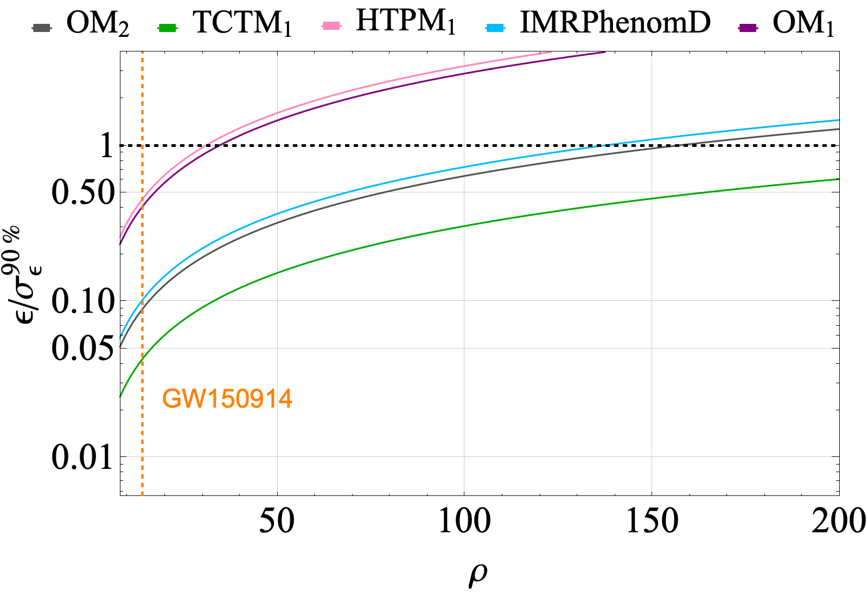
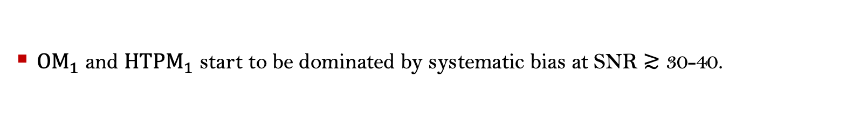
Bias
${OM}_{1}$ and ${HTPM}_{1}$ start to be dominated by systematic bias at SNR $≳$ 30-40.

Slide 12
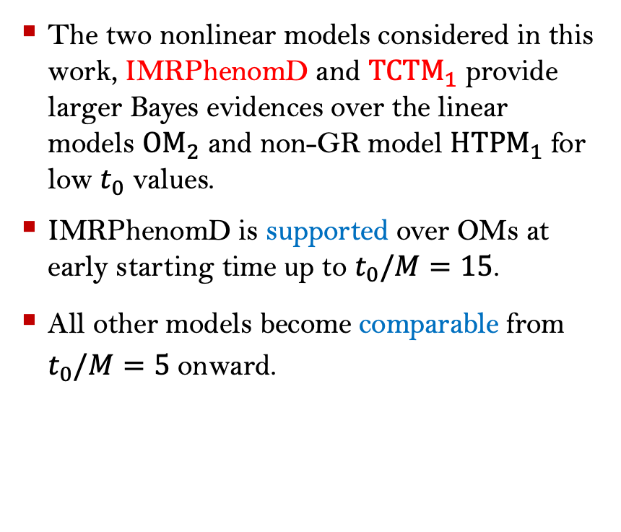
Ringdown starting time dependence
The two nonlinear models considered in this work, IMRPhenomD and ${TCTM}_{1}$ provide larger Bayes evidences over the linear models ${OM}_{2}$ and non-GR model ${HTPM}_{1}$ for low $t_{0}$ values.
IMRPhenomD is supported over OMs at early starting time up to $t_{0}/M=15$.
All other models become comparable from $t_{0}/M=5$ onward.

Slide 13
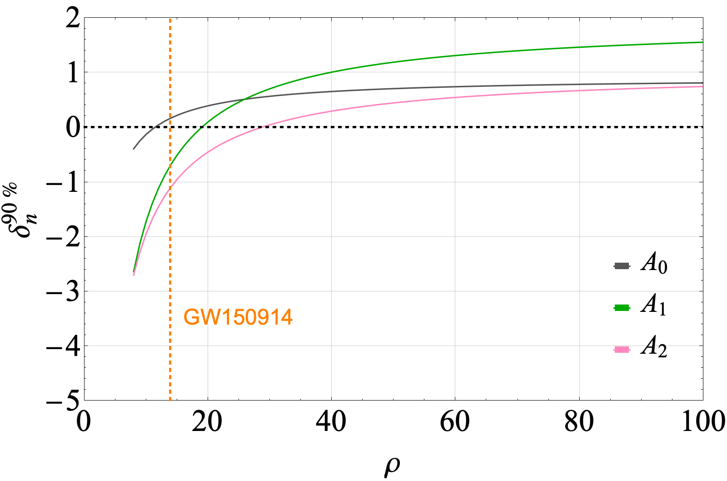
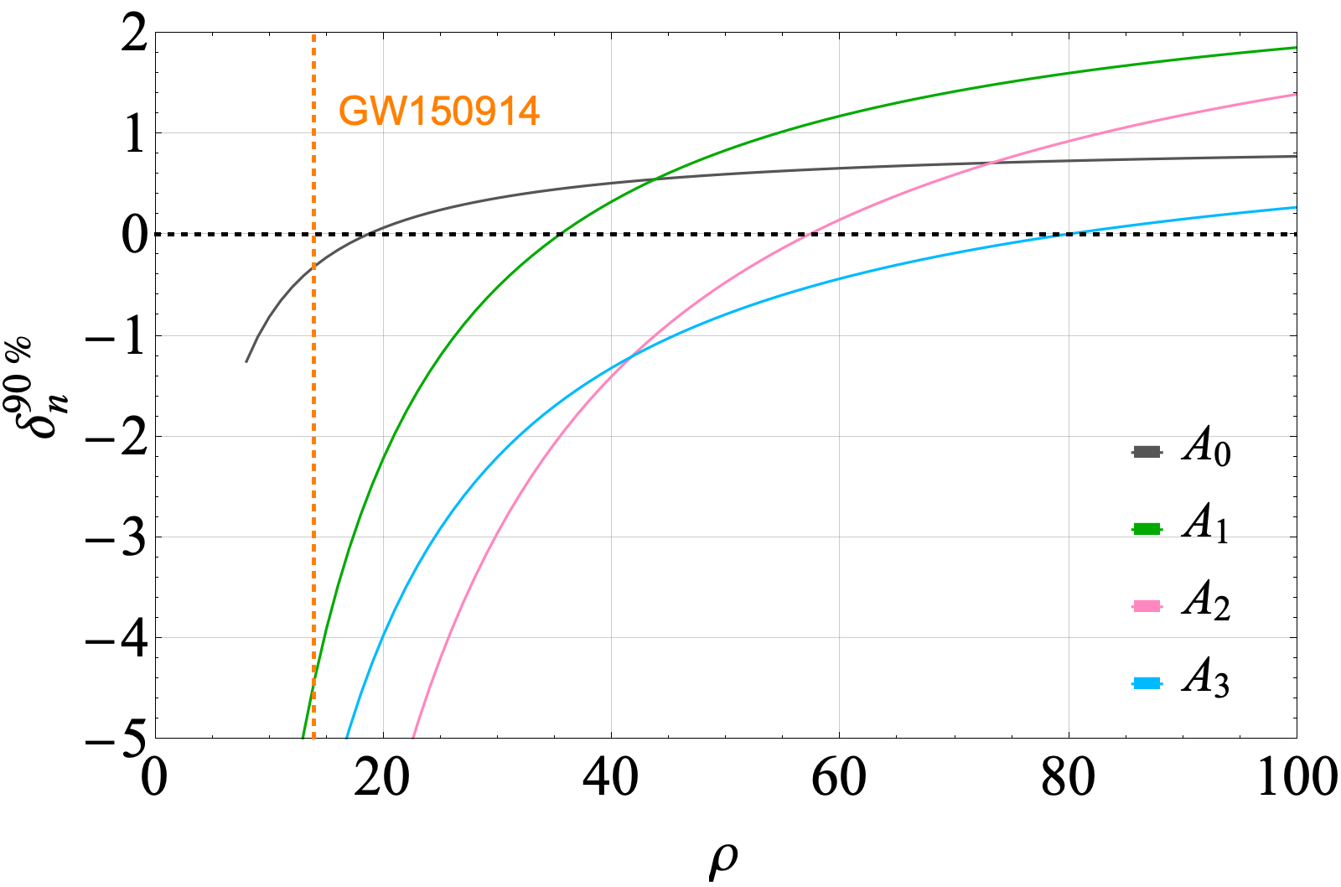
Higher tone amplitudes observability
For overtone models, confident observations of the N = 2, 3 overtones require large SNRs in the ringdown O(30-100).
Notes:
Just talk about the general trend, more about comparing the tone’s amplitude in different models. To resolve higher tones, you need high SNR as the plots suggest.

Slide 14
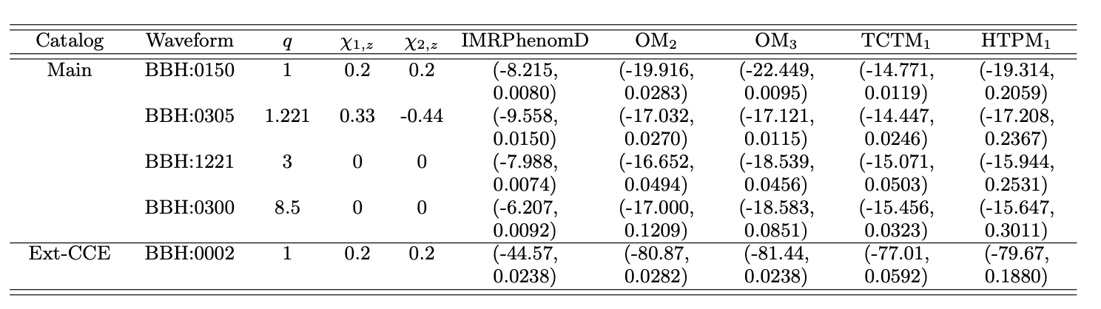
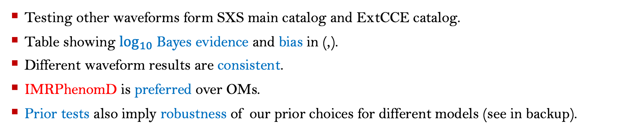
Robustness test
Testing other waveforms form SXS main catalog and ExtCCE catalog.
Table showing $\log_{10}$ Bayes evidence and bias in (,).
Different waveform results are consistent.
IMRPhenomD is preferred over OMs.
Prior tests also imply robustness of our prior choices for different models (see in backup).

Slide 15
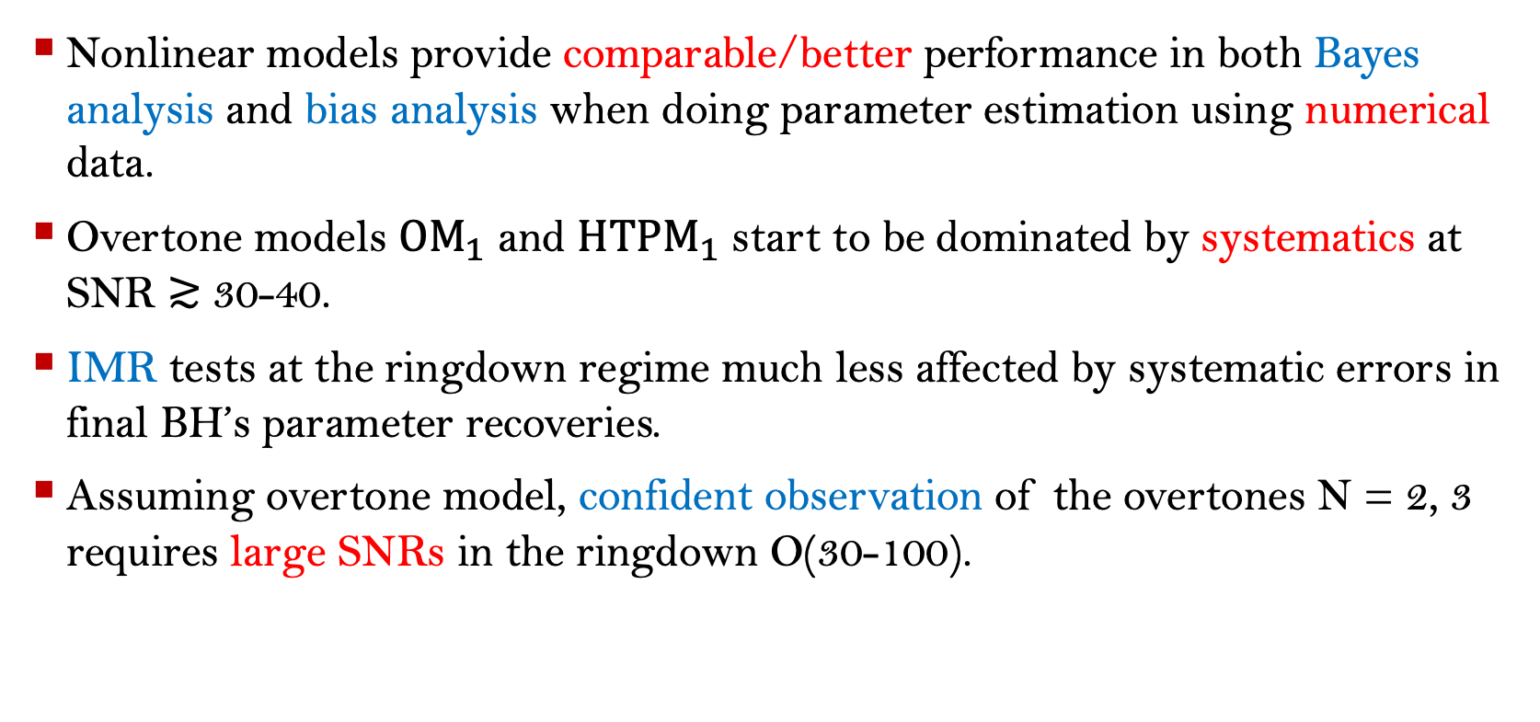
Conclusions
Nonlinear models provide comparable/better performance in both Bayes analysis and bias analysis when doing parameter estimation using numerical data.
Overtone models ${OM}_{1}$ and ${HTPM}_{1}$ start to be dominated by systematics at SNR $≳$ 30-40.
IMR tests at the ringdown regime much less affected by systematic errors in final BH’s parameter recoveries.
Assuming overtone model, confident observation of the overtones N = 2, 3 requires large SNRs in the ringdown O(30-100).
Notes:
Think about future prospects.

Slide 16
Thank you

Slide 17
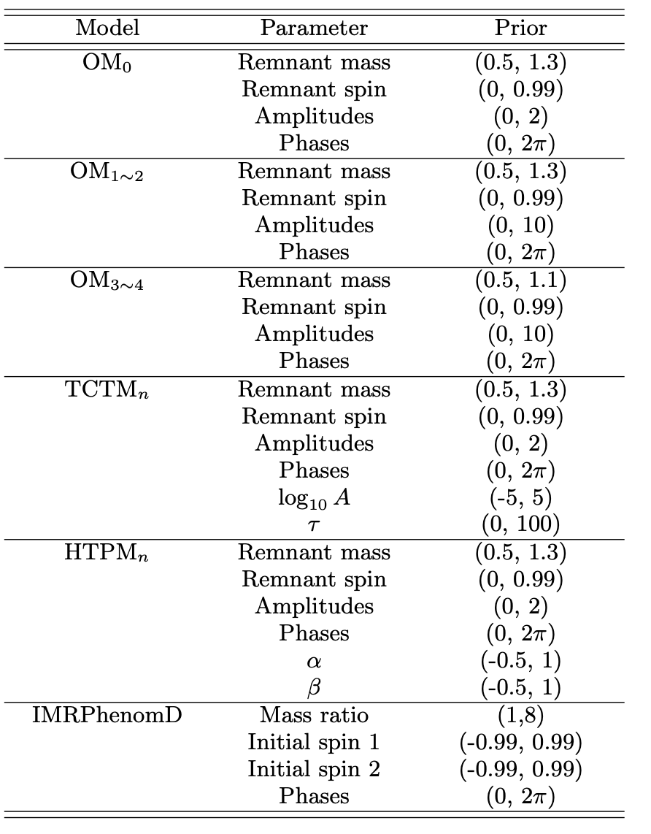
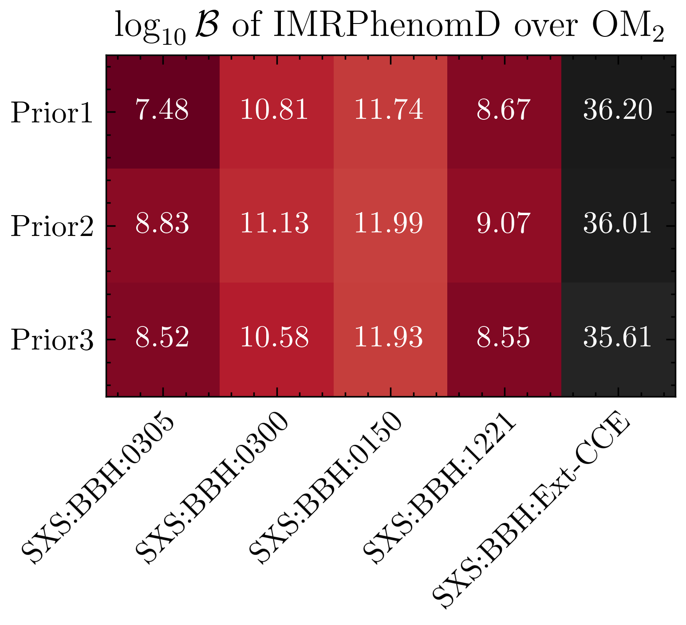
Backup slide: prior test
"Prior1", "Prior2", "Prior3" are used to denote different ranges for the final mass prior of, (0.5, 1.3), (0.7, 1.2) and (0.8, 1.1)
Different prior ranges tests also prove the robustness of our choices in parameter estimation.

